Slide 1
COMP 2710 Software Construction
How to debug programs
Flow of Control
Dr. Xiao Qin
Auburn University
http://www.eng.auburn.edu/~xqin
xqin@auburn.edu
Fall, 2012
Some slides are adapted from notes by Dr. Walter Savitch (UCSD)

Slide 2
Homework 2 – A case study
How to find bugs?
Where is the bug in this sample program?
1-<number>
Notes:
Fall’11-homework 1

Slide 3
Writing structured code and data
Lots of well-defined functions/modules
Using structured loop constructs (i.e., while and for) instead of goto.
Using variables that have one purpose and meaningful names.
Using structured data types to represent complex data.
Using the ADT (Abstract Data Type) or OOP (Object-Oriented Programming) paradigm of programming
1-<number>
Notes:
Fall’11-homework 1

Slide 4
Debugging Tools
The assert Macro
e.g., assert( x != 0 );
Print Statements
Debuggers (GDB)
Walk through
1-<number>
Notes:
Fall’11-homework 1

Slide 5
Finding Debugs – Testing!
When you are trying to fix a bug, one function or module at a time.
Aggressively test programs!
Start with small problems
Test every feature of the program at least once! And is once really enough?
Do not forget to test trivial problems.
Do not make invalid assumptions about input data.
1-<number>
Notes:
Fall’11-homework 1

Slide 6
Objectives
Boolean Expressions
  Building, Evaluating & Precedence Rules
Branching Mechanisms
  if-else
  switch
  Nesting if-else
Loops
  While, do-while, for
  Nesting loops
Copyright © 2008 Pearson Addison-Wesley. All rights reserved.
2-<number>

Slide 7
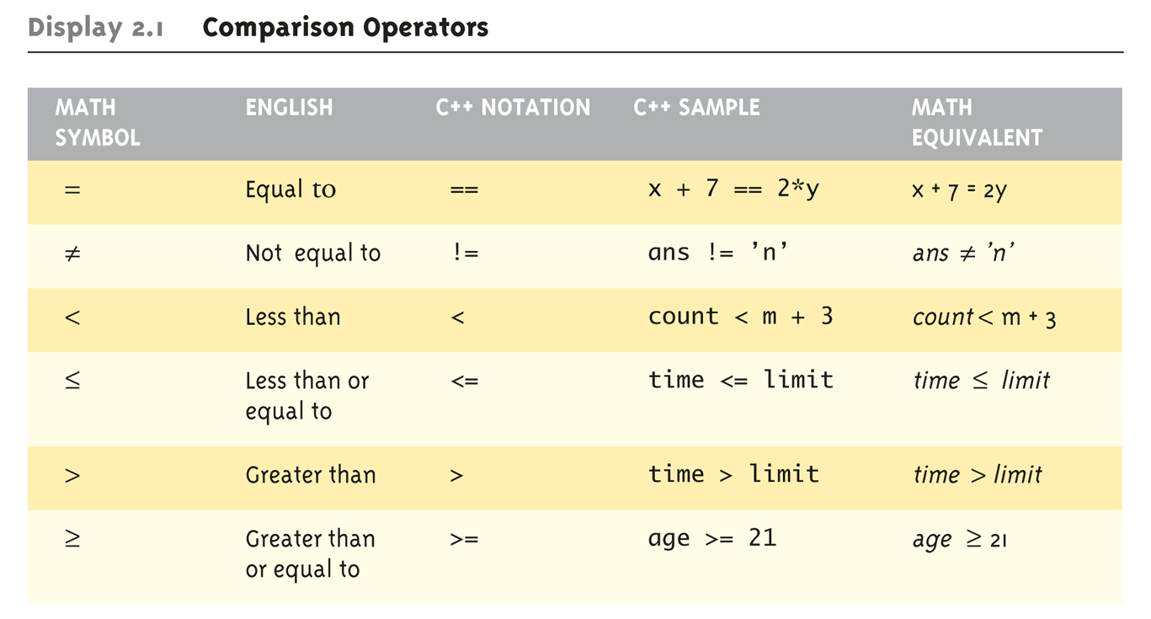
Boolean Expressions:
Display 2.1 Comparison Operators
Logical Operators
  Logical AND (&&)
  Logical OR (||)
Copyright © 2008 Pearson Addison-Wesley. All rights reserved.
2-<number>
Notes:
Equality and Relational Operators

Slide 8
Evaluating Boolean Expressions
Data type bool
  Returns true or false
  true, false are predefined library consts
Truth tables
  Display 2.2 next slide
Copyright © 2008 Pearson Addison-Wesley. All rights reserved.
2-<number>

Slide 9
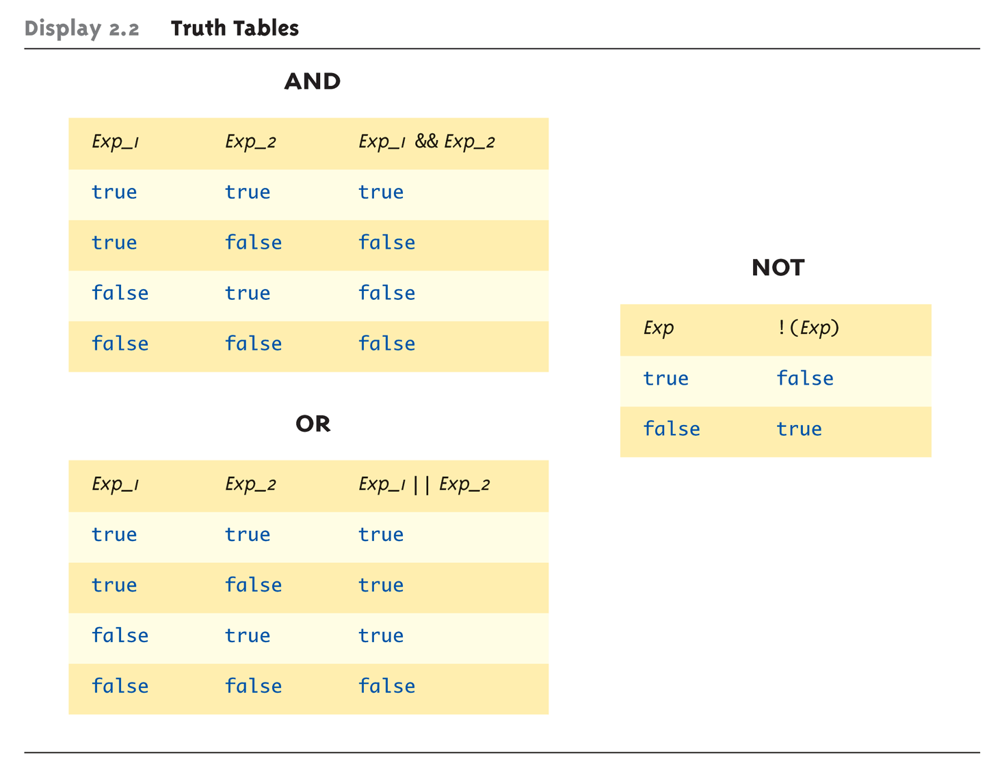
Evaluating Boolean Expressions: Display 2.2 Truth Tables
Copyright © 2008 Pearson Addison-Wesley. All rights reserved.
2-<number>
Notes:
Like the truth tables in Java

Slide 10
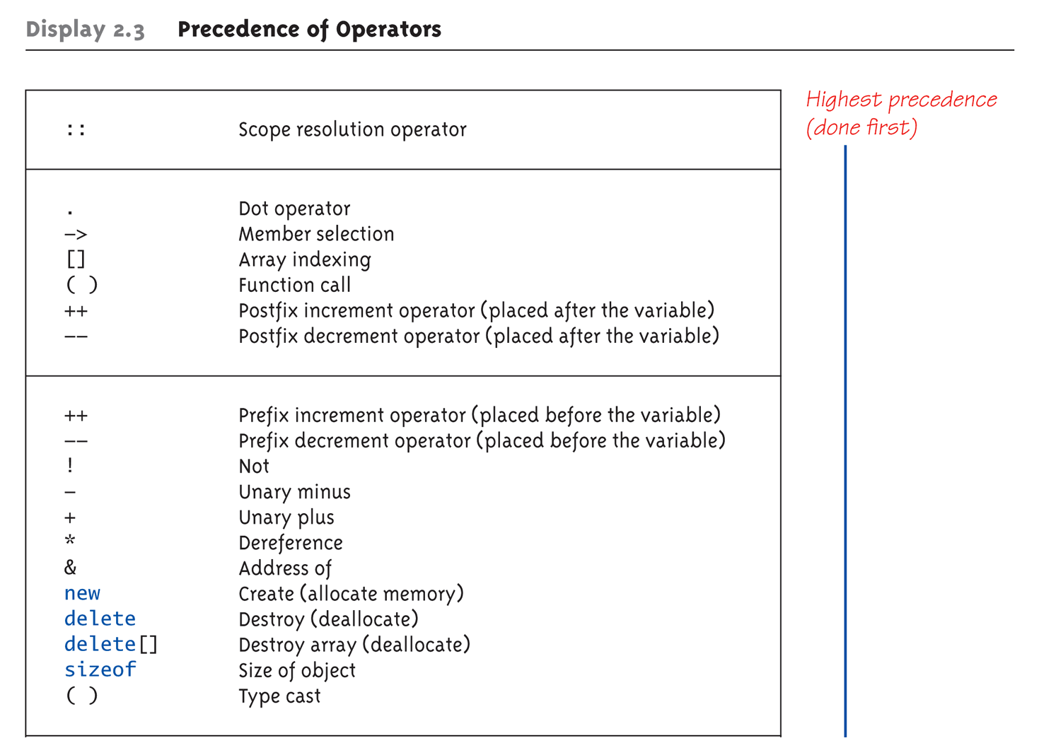
Display 2.3
Precedence of Operators (1 of 4)
Copyright © 2008 Pearson Addison-Wesley. All rights reserved.
2-<number>

Slide 11
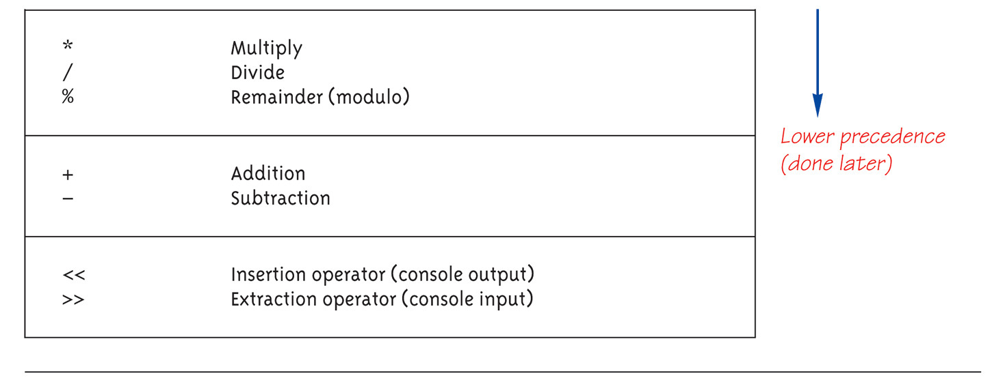
Display 2.3
Precedence of Operators (2 of 4)
Copyright © 2008 Pearson Addison-Wesley. All rights reserved.
2-<number>

Slide 12
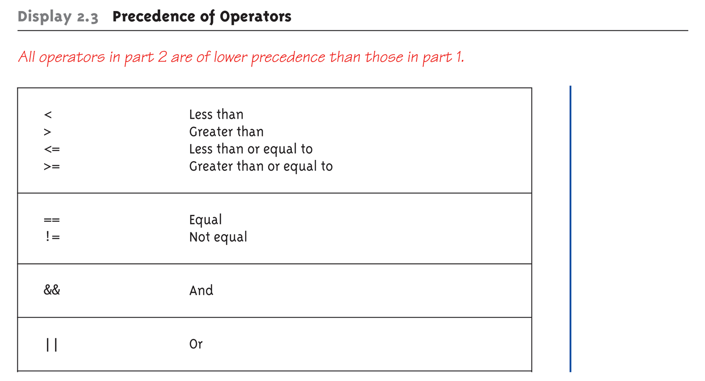
Display 2.3
Precedence of Operators (3 of 4)
Copyright © 2008 Pearson Addison-Wesley. All rights reserved.
2-<number>

Slide 13
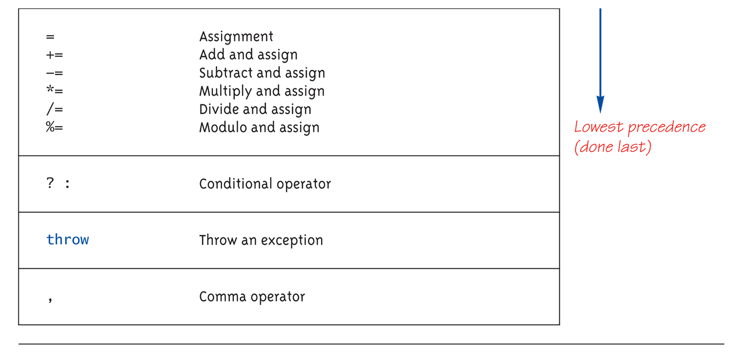
Display 2.3
Precedence of Operators (4 of 4)
Copyright © 2008 Pearson Addison-Wesley. All rights reserved.
2-<number>

Slide 14
Precedence Examples
Arithmetic before logical
  x + 1 > 2 || x + 1 < -3 means:
    (x + 1) > 2 || (x + 1) < -3
Short-circuit evaluation
  (x >= 0) && (y > 1)
  Be careful with increment operators!
    (x > 1) && (y++)
Integers as boolean values
  All non-zero values → true
  Zero value → false
Copyright © 2008 Pearson Addison-Wesley. All rights reserved.
2-<number>

Slide 15
Branching Mechanisms
if-else statements
  Choice of two alternate statements based
  on condition expression
  Example:
  if (hrs > 40)
  grossPay = rate*40 + 1.5*rate*(hrs-40);
  else
  grossPay = rate*hrs;
Copyright © 2008 Pearson Addison-Wesley. All rights reserved.
2-<number>
Notes:
Like if-else statements in Java

Slide 16
if-else Statement Syntax
Formal syntax:
if (<boolean_expression>)
<yes_statement>
else
<no_statement>
Note each alternative is only
ONE statement!
To have multiple statements execute in
either branch → use compound statement
Copyright © 2008 Pearson Addison-Wesley. All rights reserved.
2-<number>

Slide 17
Compound/Block Statement
Only "get" one statement per branch
Must use compound statement { }
for multiples
  Also called a "block" stmt
Each block should have block statement
  Even if just one statement
  Enhances readability
Copyright © 2008 Pearson Addison-Wesley. All rights reserved.
2-<number>

Slide 18
Compound Statement in Action
Note indenting in this example:
if (myScore > yourScore) {
cout << "I win!\n";
wager = wager + 100;
}
else {
cout << "I wish these were golf scores.\n";
wager = 0;
}
Copyright © 2008 Pearson Addison-Wesley. All rights reserved.
2-<number>

Slide 19
Common Pitfalls
Operator "=" vs. operator "=="
One means "assignment" (=)
One means "equality" (==)
  VERY different in C++!
  Example:
  x = 11;
  if (x = 12) ←Note operator used!
  Do_Something
  else
  Do_Something_Else
Copyright © 2008 Pearson Addison-Wesley. All rights reserved.
2-<number>

Slide 20
The Optional else
else clause is optional
  If, in the false branch (else), you want "nothing" to happen, leave it out
  Example:
  if (sales >= minimum)
  salary = salary + bonus;
  cout << "Salary = %" << salary;
  Note: nothing to do for false condition, so there is no else clause!
  Execution continues with cout statement
Copyright © 2008 Pearson Addison-Wesley. All rights reserved.
2-<number>

Slide 21
Nested Statements
if-else statements contain smaller statements
  Compound or simple statements (we’ve seen)
  Can also contain any statement at all, including another if-else stmt!
  Example:
  speed = 56;
  if (speed > 55)
  if (speed > 80)
  cout << "You’re really speeding!";
  else
  cout << "You’re speeding.";
    Note proper indenting!
Copyright © 2008 Pearson Addison-Wesley. All rights reserved.
2-<number>

Slide 22
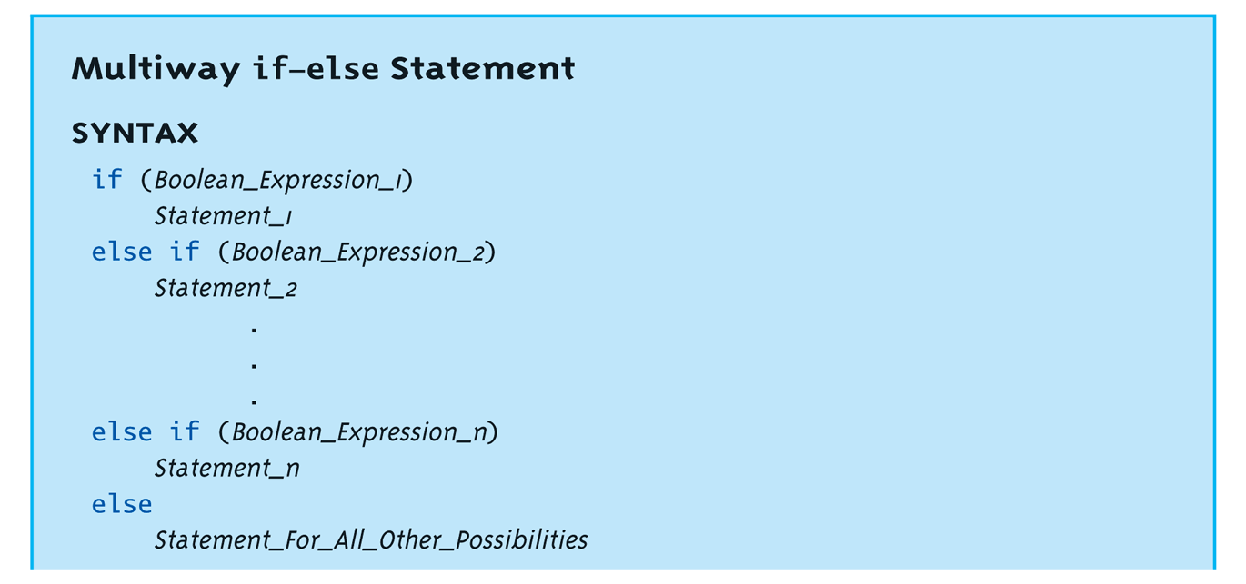
Multiway if-else: Display, page 63
Not new, just different indenting
Avoids "excessive" indenting
  Syntax:
Copyright © 2008 Pearson Addison-Wesley. All rights reserved.
2-<number>

Slide 23
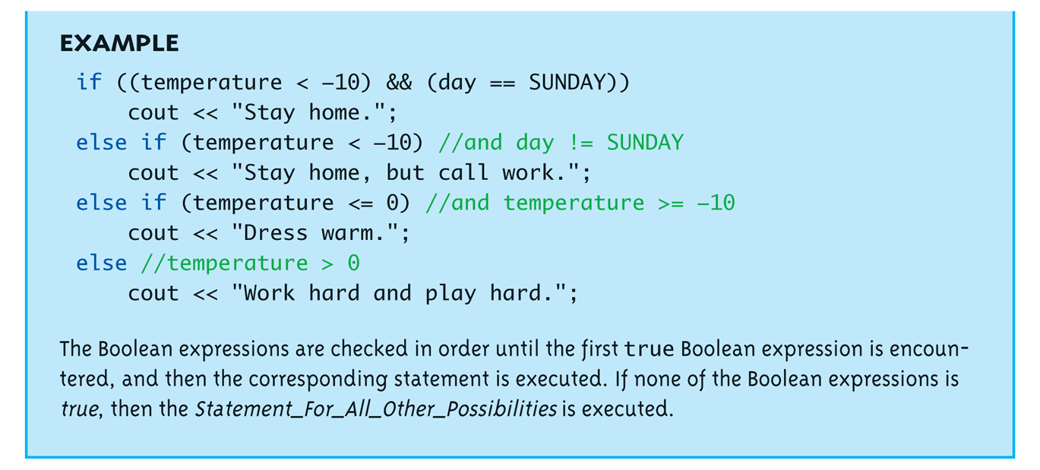
Multiway if-else Example:
Display, page 63
Copyright © 2008 Pearson Addison-Wesley. All rights reserved.
2-<number>

Slide 24
The switch Statement
A new stmt for controlling
multiple branches
Uses controlling expression which returns bool data type (true or false)
Syntax:
  Display page 62 next slide
Copyright © 2008 Pearson Addison-Wesley. All rights reserved.
2-<number>

Slide 25
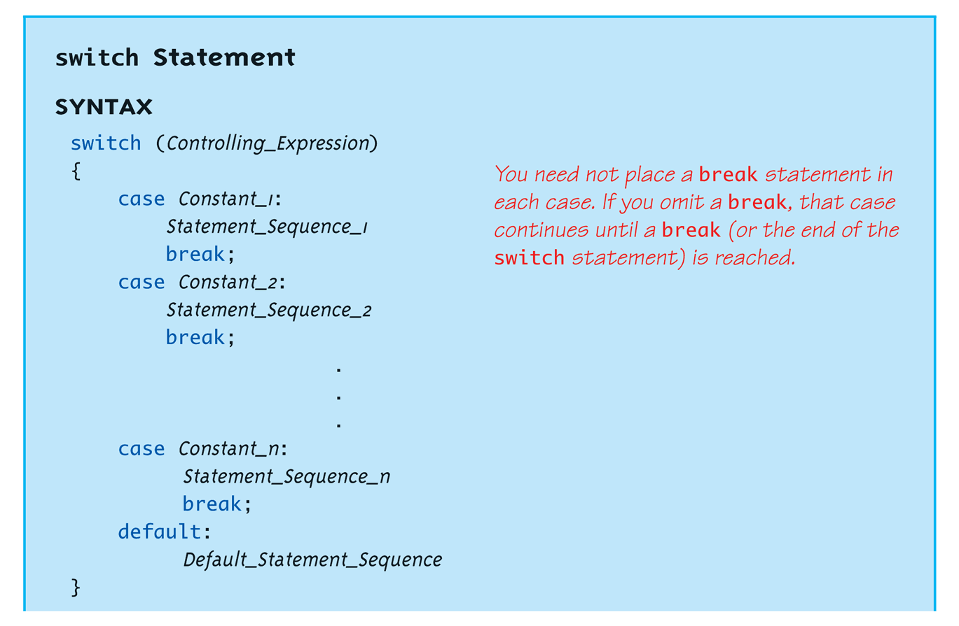
switch Statement Syntax:
Display, page 64
Copyright © 2008 Pearson Addison-Wesley. All rights reserved.
2-<number>

Slide 26
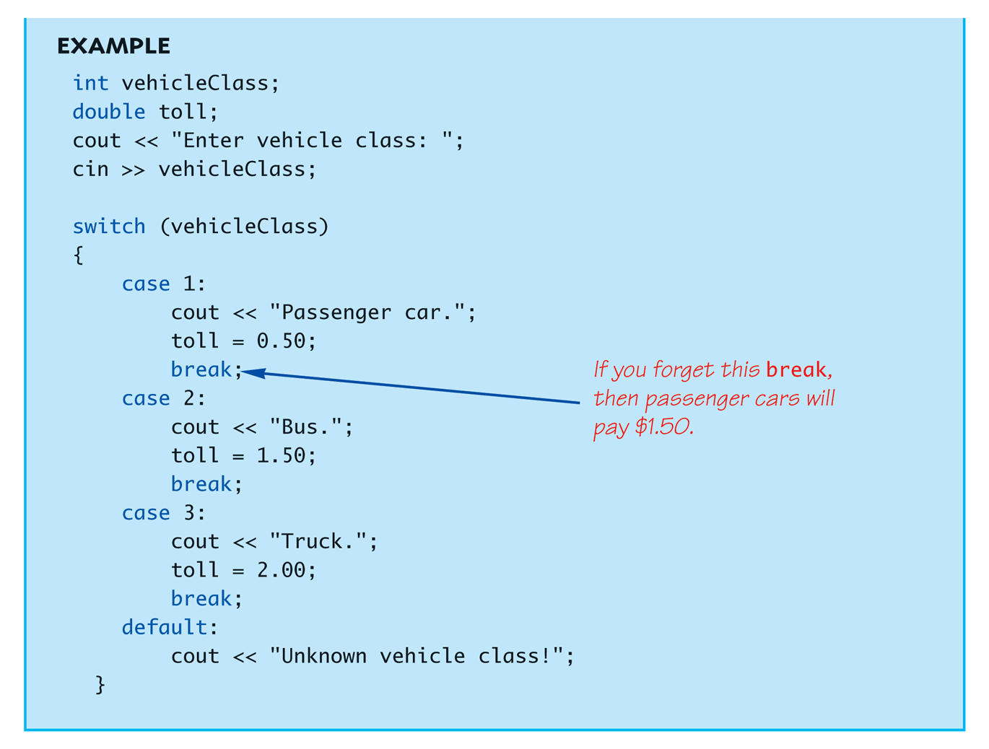
The switch Statement in Action: Display, page 64
Copyright © 2008 Pearson Addison-Wesley. All rights reserved.
2-<number>

Slide 27
The switch: multiple case labels
Execution "falls thru" until break
  switch provides a "point of entry"
  Example:
  case "A":
  case "a":
  cout << "Excellent: you got an "A"!\n";
  break;
  case "B":
  case "b":
  cout << "Good: you got a "B"!\n";
  break;
  Note multiple labels provide same "entry"
Copyright © 2008 Pearson Addison-Wesley. All rights reserved.
2-<number>

Slide 28
Summary
Boolean expressions
  Similar to arithmetic → results in true or false
C++ branching statements
  if-else, switch
  switch statement great for menus
Next Time: C++ loop statements
  while
  do-while
  for
Copyright © 2008 Pearson Addison-Wesley. All rights reserved.
2-<number>

Slide 29
Loops
3 Types of loops in C++
  while
    Most flexible
    No "restrictions"
  do-while
    Least flexible
    Always executes loop body at least once
  for
    Natural "counting" loop
Copyright © 2008 Pearson Addison-Wesley. All rights reserved.
2-<number>

Slide 30
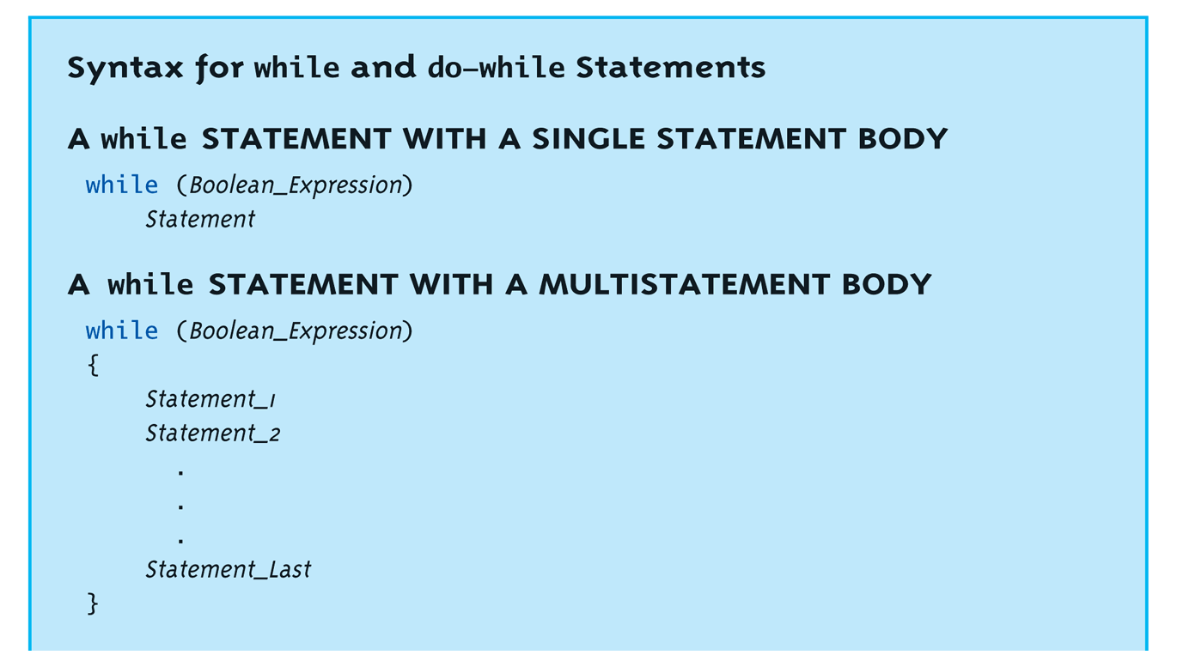
while Loops Syntax
Copyright © 2008 Pearson Addison-Wesley. All rights reserved.
2-<number>

Slide 31
while Loop Example
Consider:
count = 0; // Initialization
while (count < 3) // Loop Condition
{
cout << "Hi "; // Loop Body
count++; // Update expression
}
Loop body executes how many times?
Copyright © 2008 Pearson Addison-Wesley. All rights reserved.
2-<number>

Slide 32
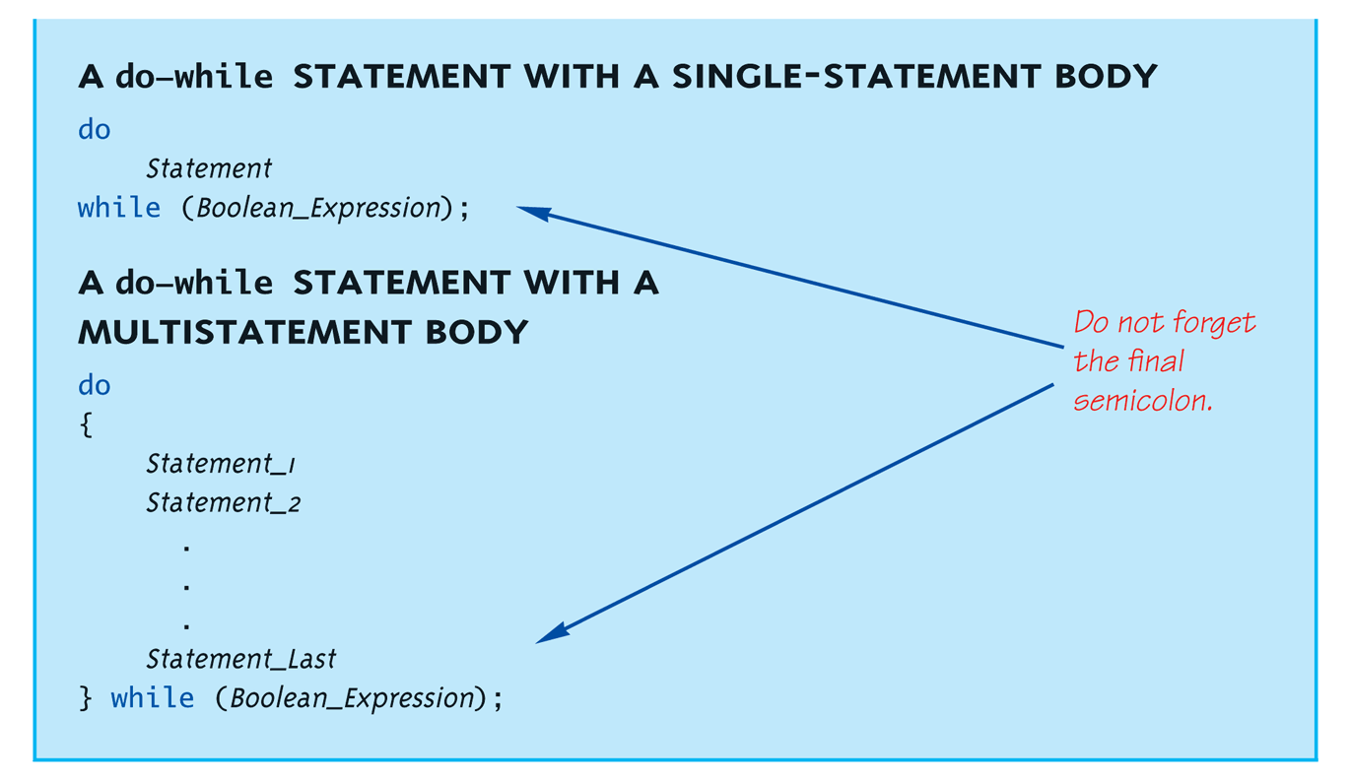
do-while Loop Syntax
Often used for menu applications. Why?
Copyright © 2008 Pearson Addison-Wesley. All rights reserved.
2-<number>
Notes:
Often used for menu applications. Why?
Execute at least onece.

Slide 33
do-while Loop Example
count = 0; // Initialization
do
{
cout << "Hi "; // Loop Body
count++; // Update expression
} while (count < 3); // Loop Condition
  Loop body executes how many times?
  do-while loops always execute body at least once!
Copyright © 2008 Pearson Addison-Wesley. All rights reserved.
2-<number>
Notes:
3

Slide 34
while vs. do-while
Very similar, but…
  One important difference
    Issue is "WHEN" boolean expression is checked
    while: checks BEFORE body is executed
    do-while: checked AFTER body is executed
After this difference, they’re
essentially identical!
while is more common, due to it’s
ultimate "flexibility"
Copyright © 2008 Pearson Addison-Wesley. All rights reserved.
2-<number>

Slide 35
Comma Operator
Evaluate list of expressions, returning
value of the last expression
Most often used in a for-loop
Example:
first = (first = 2, second = first + 1);
  first gets assigned the value 3
  second gets assigned the value 3
No guarantee what order expressions will
be evaluated.
Copyright © 2008 Pearson Addison-Wesley. All rights reserved.
2-<number>

Slide 36
for Loop Syntax
for (Init_Action; Bool_Exp; Update_Action)
Body_Statement
Like if-else, Body_Statement can be
a block statement
  Much more typical
Copyright © 2008 Pearson Addison-Wesley. All rights reserved.
2-<number>

Slide 37
for Loop Example
for (count=0;count<3;count++)
{
cout << "Hi "; // Loop Body
}
How many times does loop body execute?
Initialization, loop condition and update all
"built into" the for-loop structure!
A natural "counting" loop
Copyright © 2008 Pearson Addison-Wesley. All rights reserved.
2-<number>

Slide 38
Loop Issues
Loop’s condition expression can be ANY boolean expression
Examples:
  while (count<3 && done!=0)
  {
  // Do something
  }
  for (index=0;index<10 && entry!=-99;index++)
  {
  // Do something
  }
Copyright © 2008 Pearson Addison-Wesley. All rights reserved.
2-<number>

Slide 39
Loop Pitfalls: Misplaced ;
Watch the misplaced ; (semicolon)
  Example:
  while (response != 0) ;←
  {
  cout << "Enter val: ";
  cin >> response;
  }
  Notice the ";" after the while condition!
Result here: INFINITE LOOP!
Copyright © 2008 Pearson Addison-Wesley. All rights reserved.
2-<number>

Slide 40
Loop Pitfalls: Infinite Loops
Loop condition must evaluate to false at
some iteration through loop
  If not → infinite loop.
  Example:
  while (1)
  {
  cout << "Hello ";
  }
  A perfectly legal C++ loop → always infinite!
Infinite loops can be desirable
  e.g., "Embedded Systems"
Copyright © 2008 Pearson Addison-Wesley. All rights reserved.
2-<number>

Slide 41
The break and continue Statements
Flow of Control
  Recall how loops provide "graceful" and clear flow of control in and out
  In RARE instances, can alter natural flow
break;
  Forces loop to exit immediately.
continue;
  Skips rest of loop body
These statements violate natural flow
  Only used when absolutely necessary!
Copyright © 2008 Pearson Addison-Wesley. All rights reserved.
2-<number>

Slide 42
Nested Loops
Recall: ANY valid C++ statements can be
inside body of loop
This includes additional loop statements!
  Called "nested loops"
Requires careful indenting:
for (outer=0; outer<5; outer++)
for (inner=7; inner>2; inner--)
cout << outer << inner;
  Notice no { } since each body is one statement
  Good style dictates we use { } anyway
Copyright © 2008 Pearson Addison-Wesley. All rights reserved.
2-<number>
Notes:
How many time the loop body will execute?

Slide 43
Summary - loop
do-while loops
  Always execute their loop body at least once
for-loop
  A natural "counting" loop
Loops can be exited early
  break statement
  continue statement
  Usage restricted for style purposes
Copyright © 2008 Pearson Addison-Wesley. All rights reserved.
2-<number>

